Slide 1
Introduction to Computer Science and Programming
Labo 14 – C++ Pointers
Laboratory 14, March 19, 2026
Filippo Ricca - Muhammad Mohsin
DIBRIS, University of Genova

Slide 2
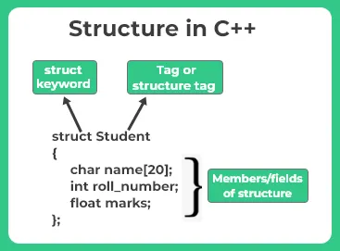
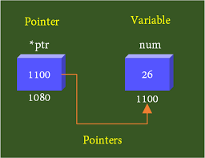
Today…
Today’s lab is dedicated to C++ Pointers
Exercise 1: Matrix Traversal Using Pointers
Exercise 2: String in Reverse Order
Exercise 3: Array Traversal with Pointer Arithmetic
Exercise 4: Swapping Values Using Pointer Parameters
Exercise 5: Array Statistics with const Pointer Parameters
All the C++ programs must be delivered on Aulaweb!

Slide 3
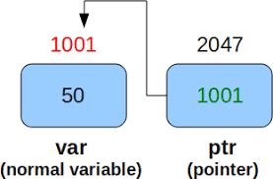
Pointers
Pointer variables, simply called pointers, are designed to hold memory addresses as their values
Normally, a variable contains a specific value, e.g., an integer, a floating-point value, and a character
However, a pointer contains the memory address of a variable that in turn contains a specific value

Slide 4
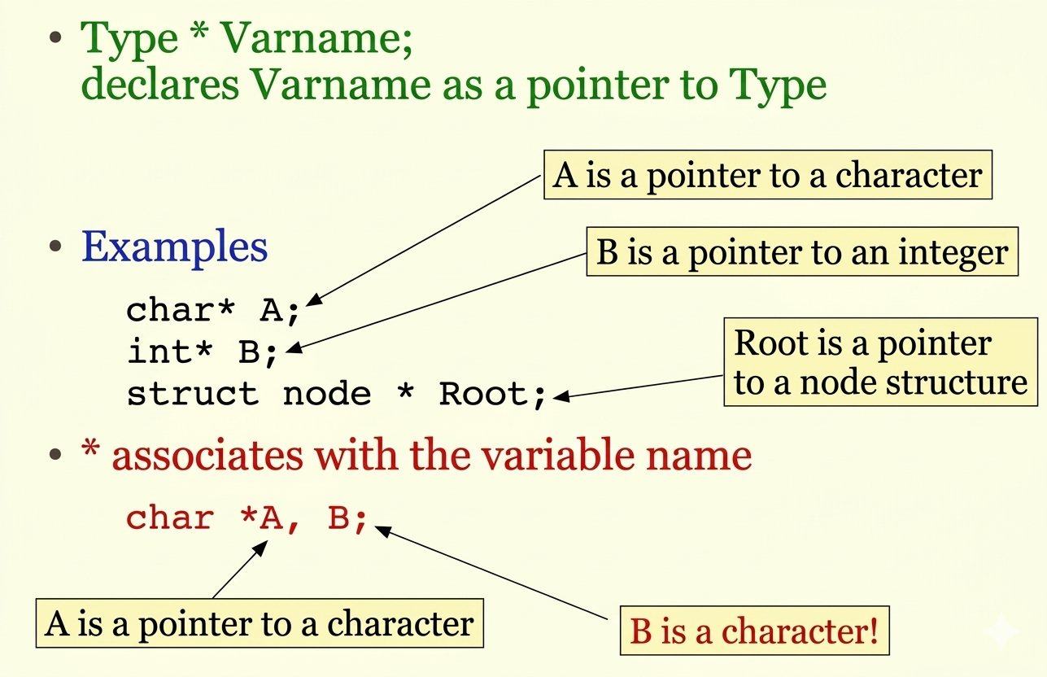
Declaring Pointers

Slide 5
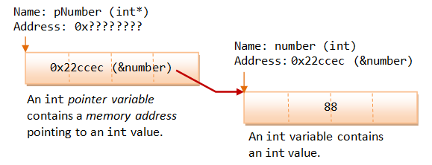
Initializing Pointers via the Address-Of Operator (&)
When you declare a pointer variable, its content is not initialized. In other words, it contains an address of "somewhere", which is of course not a valid location.

Slide 6
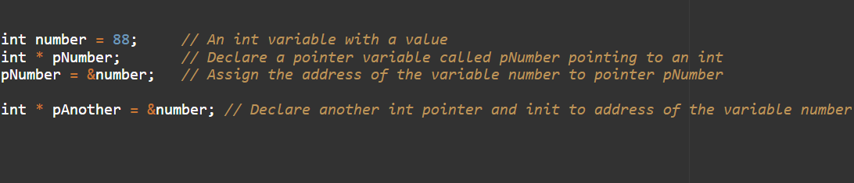
Initializing Pointers via the Address-Of Operator (&)

Slide 7
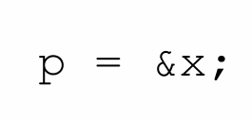

Operators
At the C++ level, we have two important operators:
REFERENCING OPERATOR (&, ampersand) Given a variable x, it returns a reference corresponding to the address of x
DEREFERENCING OPERATOR (*) Given a pointer p, it returns the variable pointed to by p

Slide 8
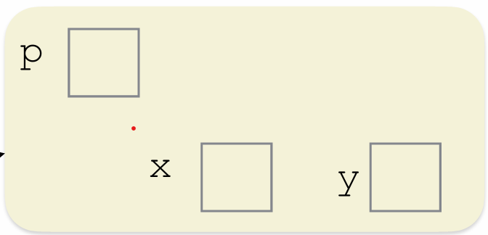
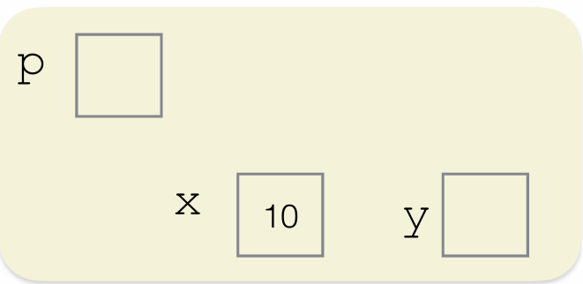
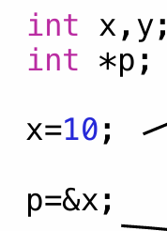
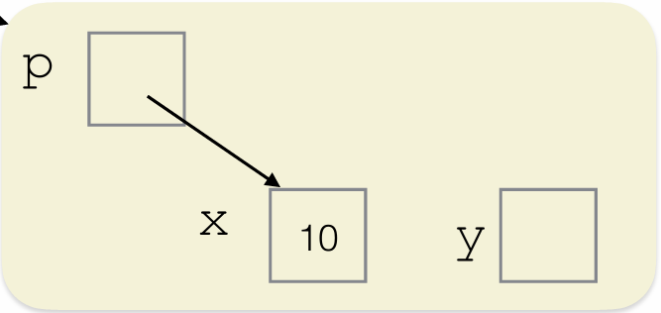
Example
p points to x
PRINT: x 10 y 0 p 0x7fff58030ab8 *p 10

Slide 9
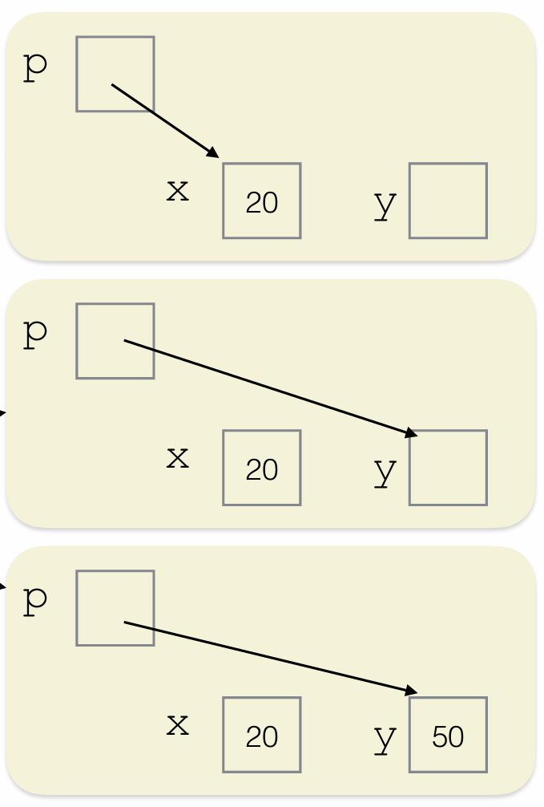
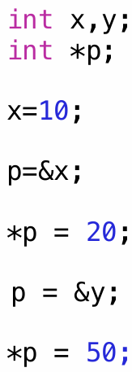
Example
PRINT: x 20 y 50 p 0x7fff58030ab4 *p 50

Slide 10
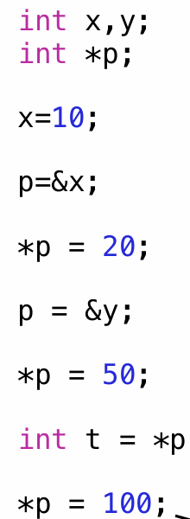
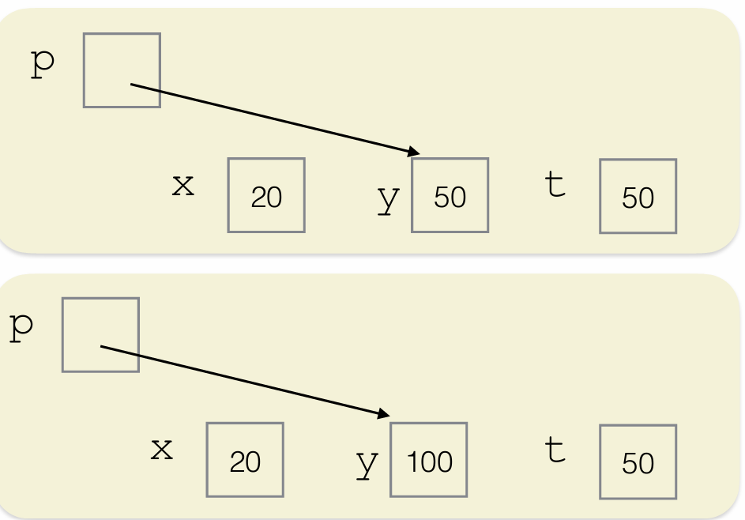
Example
PRINT: x 20 y 100 p 0x7fff58030ab4 *p 100 t 50

Slide 11
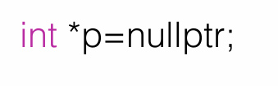
Pay attention!!
If a pointer points to an invalid memory address, the outcome of this operation cannot be predicted
Either the program aborts, or the results are meaningless...
Ex. Segmentation fault
How to initialize a pointer?
If I’m not ready to assign it a real address yet, I can use the null pointer

Slide 12
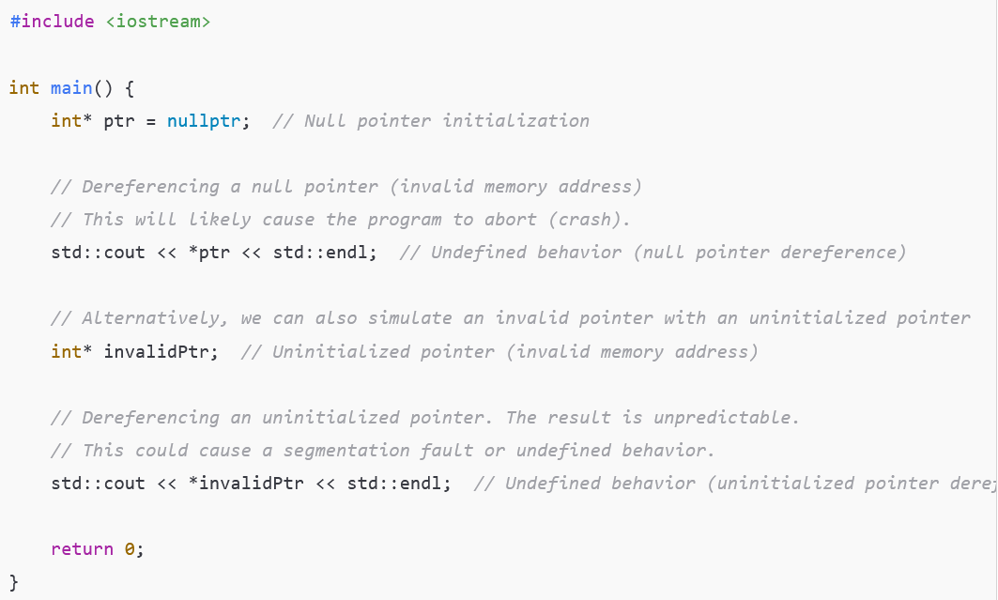

Try it!

Slide 13
Exercise 1: Matrix Traversal Using Pointers
Write a C++ program that will create a 2D matrix with user input and using pointer notation, print all the elements of matrix
Requirements:
Do not use standard array indexing like arr[i][j] for printing.
Use pointers to traverse the matrix.
Hint:
A 2D array can be accessed using pointers like: *(*(arr + i) + j)

Slide 14
Exercise 2: String in Reverse Order
Write a C++ program to ask user to enter a string and print the string in reverse order using a pointers.
Requirements:
Do not use array indexing (e.g., str[i]).
Use pointer arithmetic only.
For example:
If user enter “CPlusCplusProgrammig”
The expected output:
“gimmaragroPculpCsulPC”

Slide 15
Exercise 3: Array Traversal with Pointer Arithmetic
Given the array int scores[5] = {85, 92, 70, 88, 95}, write a function printArray(int* p, int size) that prints all elements using pointer arithmetic (no array indexing!)
Write a second function doubleValues(int* p, int size) that multiplies each element by 2 using pointer arithmetic. Call printArray before and after calling doubleValues
Important: use only *(p + i) or pointer increment (p++), never p[i]
Expected output:
Before: 85 92 70 88 95
After: 170 184 140 176 190
Hint: remember that the array name is a pointer to the first element. In doubleValues, use a local pointer copy so you do not lose the array start address

Slide 16
Exercise 4: Swapping Values Using Pointer Parameters
Write three versions of a swap function and compare their behavior:
swap1(int a, int b) pass-by-value (does NOT swap)
swap2(int* p1, int* p2) pass pointer by value (DOES swap values)
swap3(int& a, int& b) pass-by-reference (DOES swap)
In main(), declare int x = 10, y = 20. Call each function and print x and y before and after each call
Expected output:
swap1 - Before: x=10 y=20 | After: x=10 y=20
swap2 - Before: x=10 y=20 | After: x=20 y=10
swap3 - Before: x=10 y=20 | After: x=20 y=10
Hint: call swap2 with swap2(&x, &y). Inside swap2, use *p1 and *p2 to access and modify the original variables

Slide 17
Exercise 5: Array Statistics with const Pointer Parameters
Given the array int grades[6] = {72, 85, 90, 61, 78, 95}, implement the following three functions, each taking a const int* pointer parameter and the array size:
int findMin(const int* p, int size) — returns the minimum value
int findMax(const int* p, int size) — returns the maximum value
double computeAvg(const int* p, int size) — returns the average
Use pointer arithmetic (not array indexing) inside each function. The const keyword must prevent any modification of the array data — try modifying an element to see the compiler error
Expected output:
Min: 61 Max: 95 Average: 80.17
Hint: initialize min/max with *p (first element). With const int*, you can read *p but not write *p = value. Cast to double for the average calculation

